Slide 1

SAndeep

Slide 2
About ME
Born in Pune India
Big Family. Almost 18 People live in Big House together
Passion\Life Surrounds is about Reading Reading and Reading !!!
Special interest in History and Documentaries . Favorite documentary BBC Himalaya with Michael Palin
Read at least 1-2 hours day about blogs about History Wikipedia Facts Places and Autobiography.
Started Reading books at Age 2 . Its kind of special thing happen to me and developed unique skill.I can finish any big book in 2-3 hours ☺
Whichever I visit place , I always look around history about the place
Blessed to be born in India as that place have so much history around
Also study of history helped me to personally to come out of biased views and embrace other cultures regions and communities !!!
East History Vs West
North Vs South
History never takes sides. Its just facts and point of view matters .
Moving to computer sciences : Dad said world is having too many farmer go and get Engineers . This is not from interstellar movie ☺
Life beyond certain point : Historian or become into Teaching
May be in future we need more Historian than Engineers ☺
I think after some time world need better people to tell people history happened around
It also helps future generation to learn and embrace How wonderfully we involved through those years and their culture before becoming global citizen

Slide 3
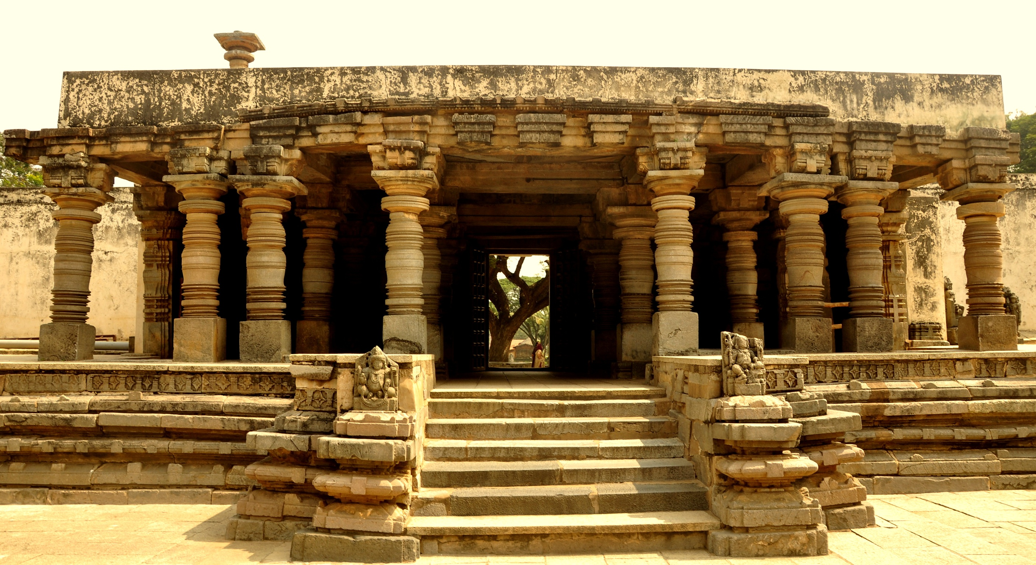
Chennakesava Temple, Somanathapura 1258 CE BANGLORE

Slide 4
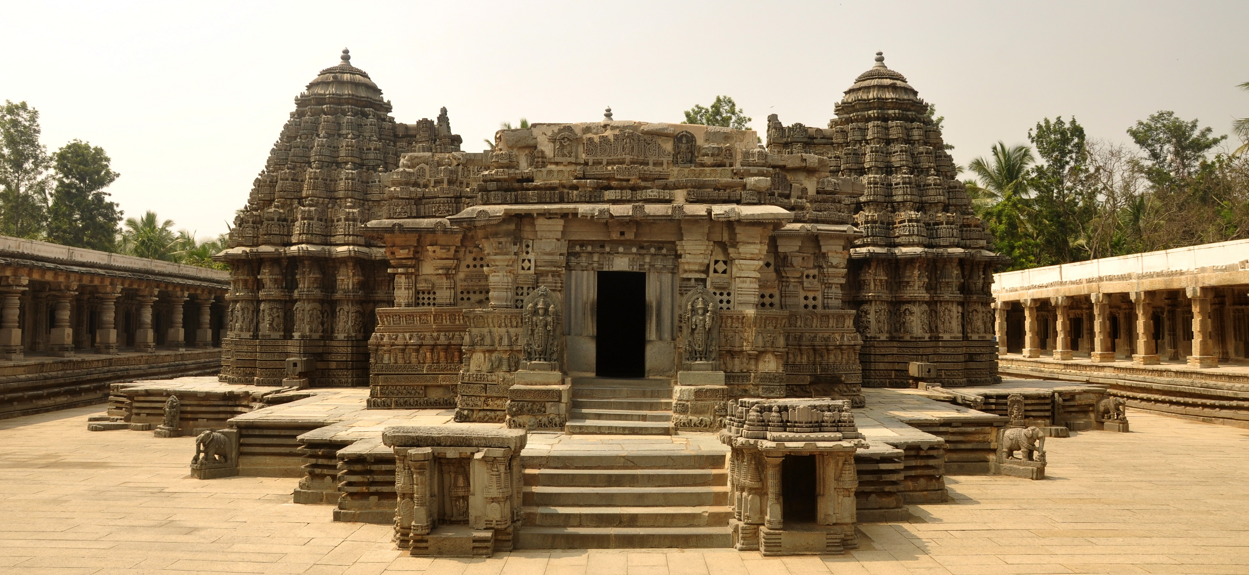

Slide 5
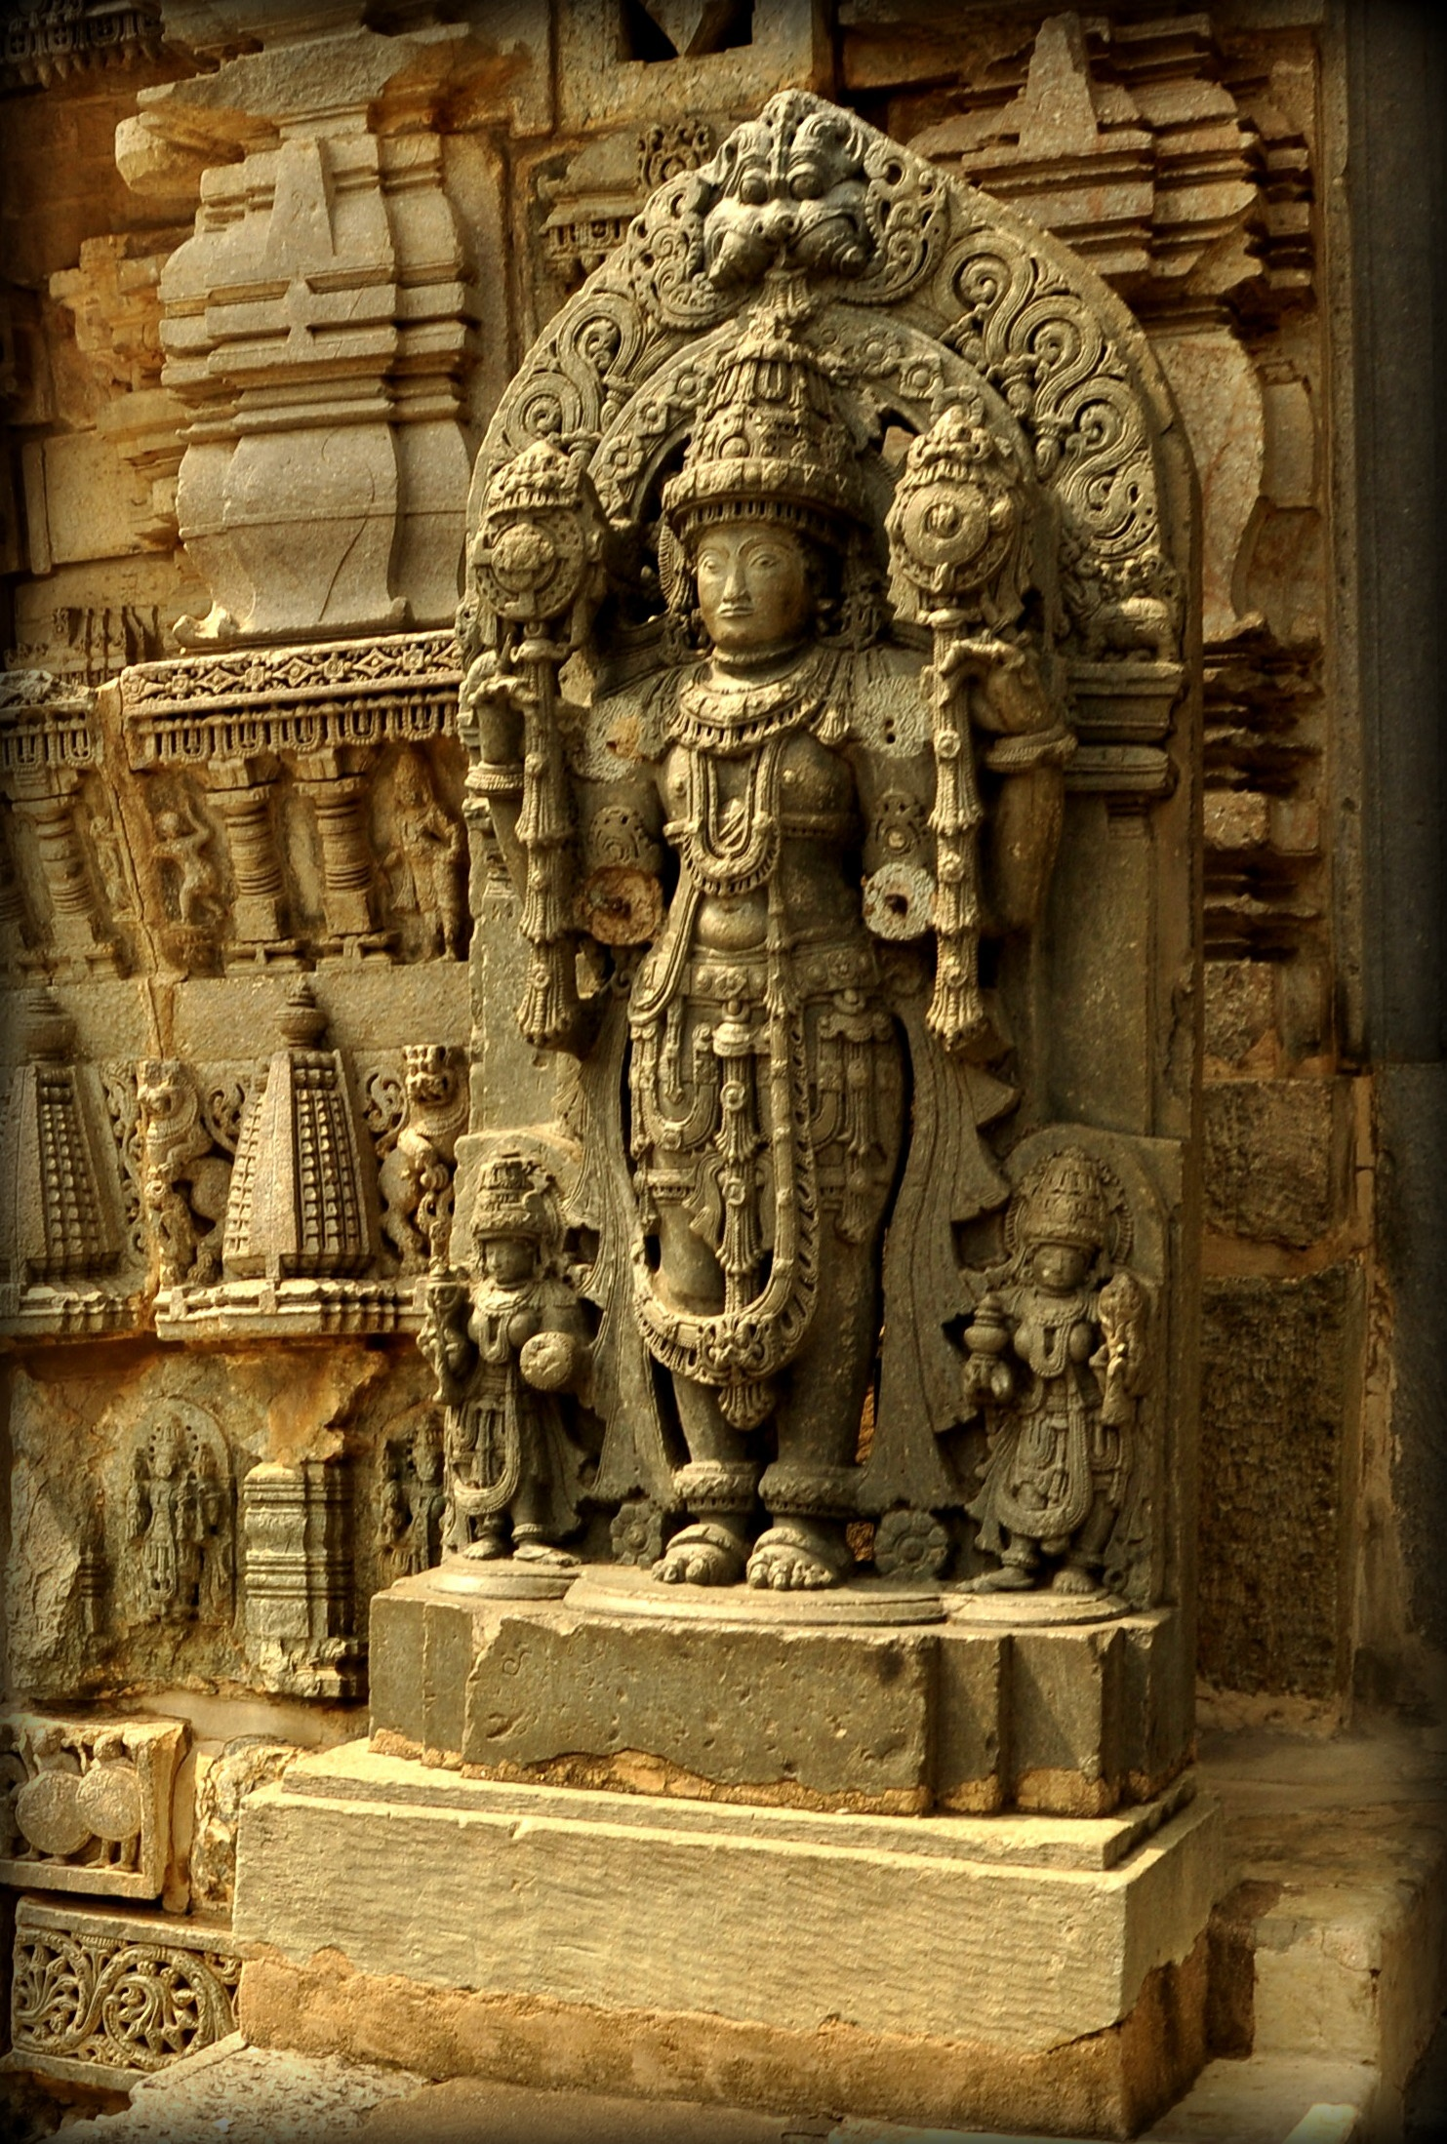
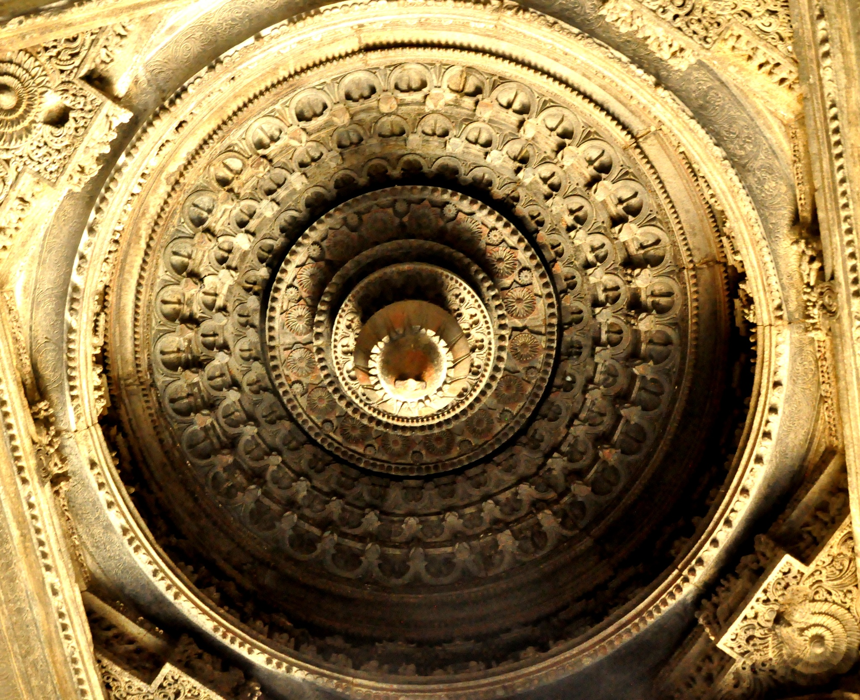

Slide 6
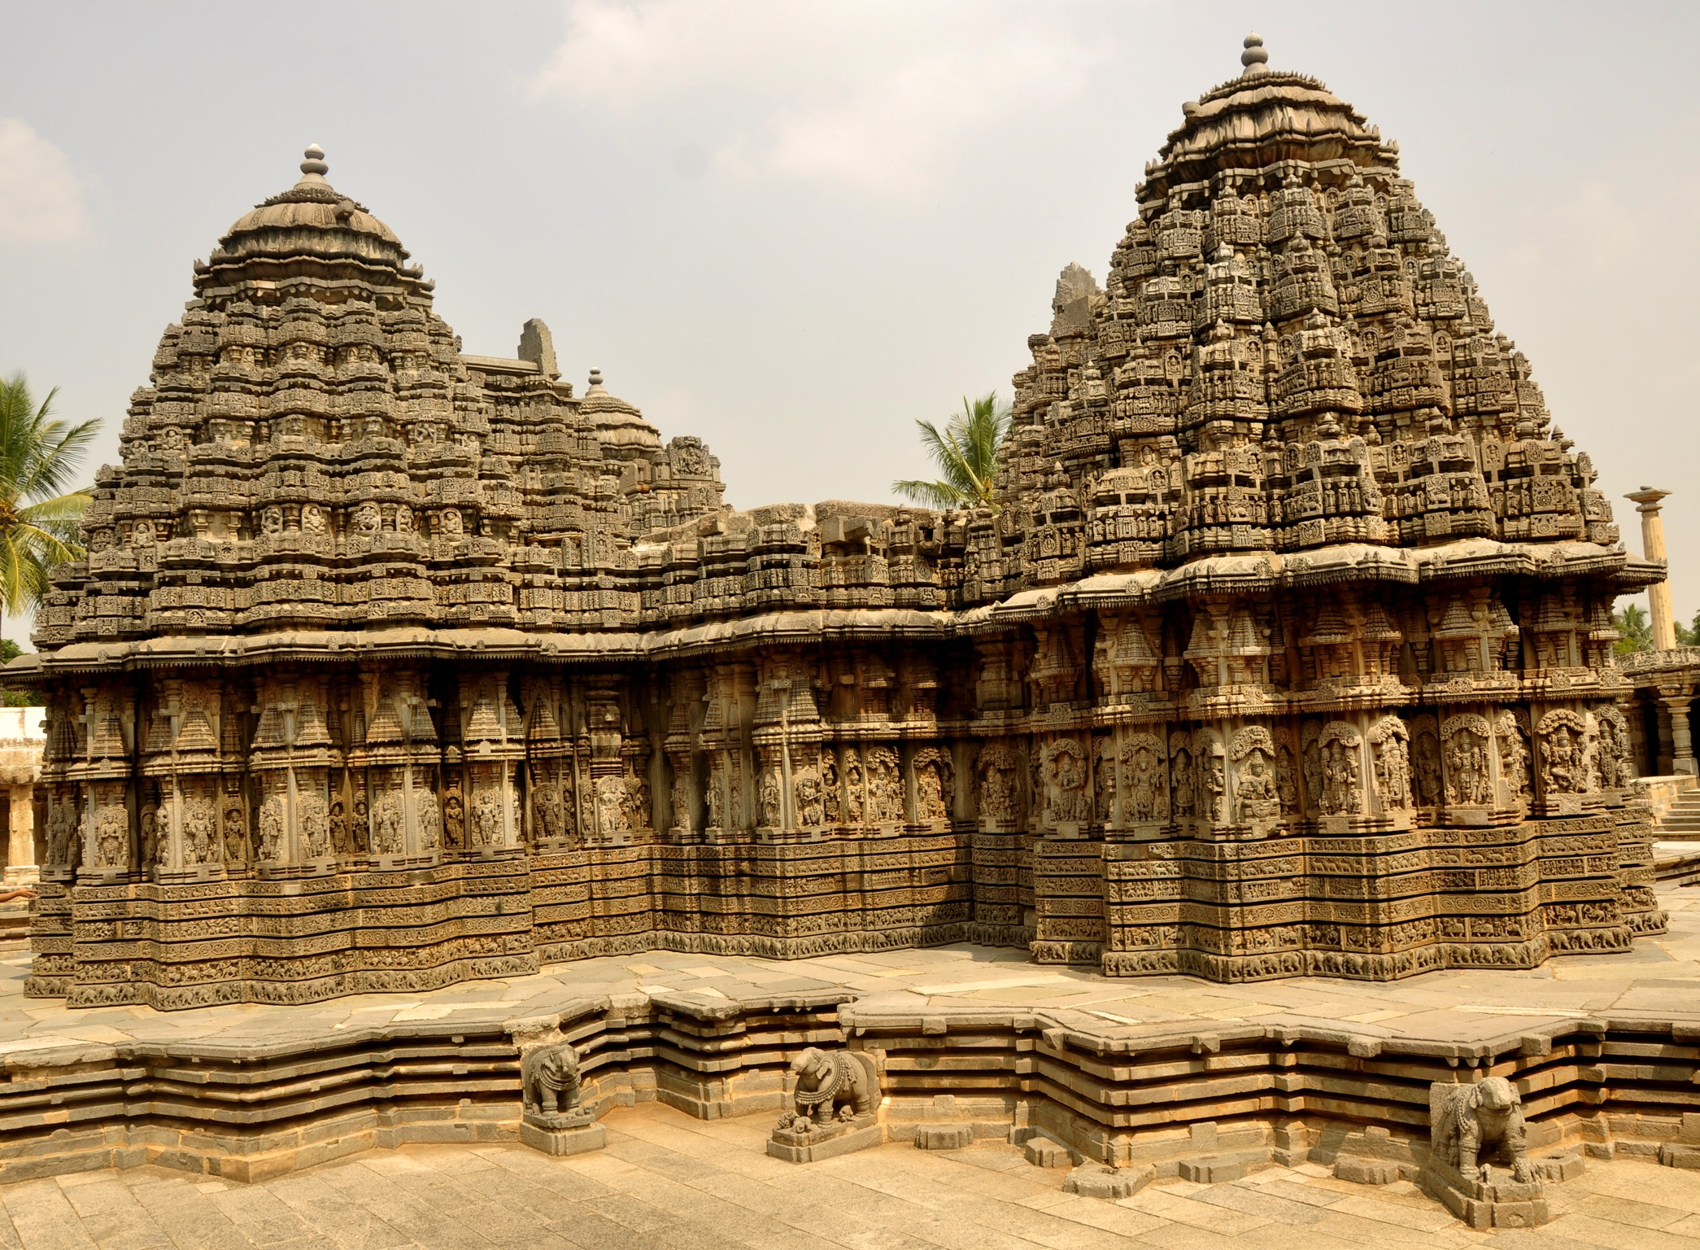

Slide 7
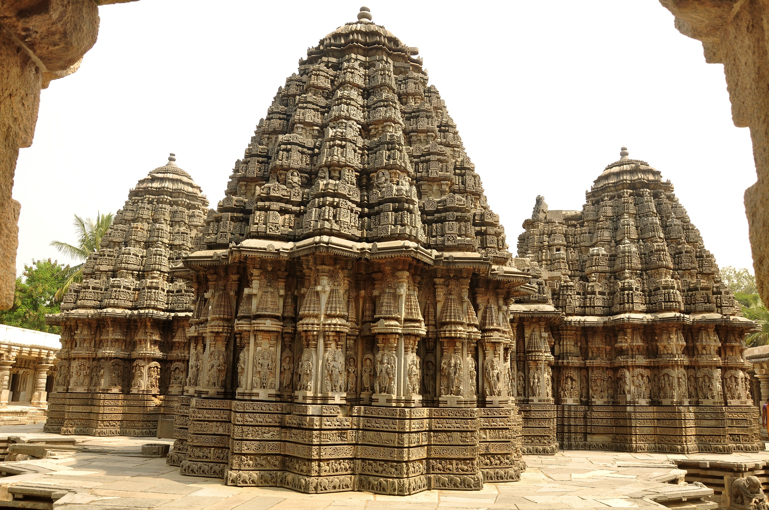

Slide 8
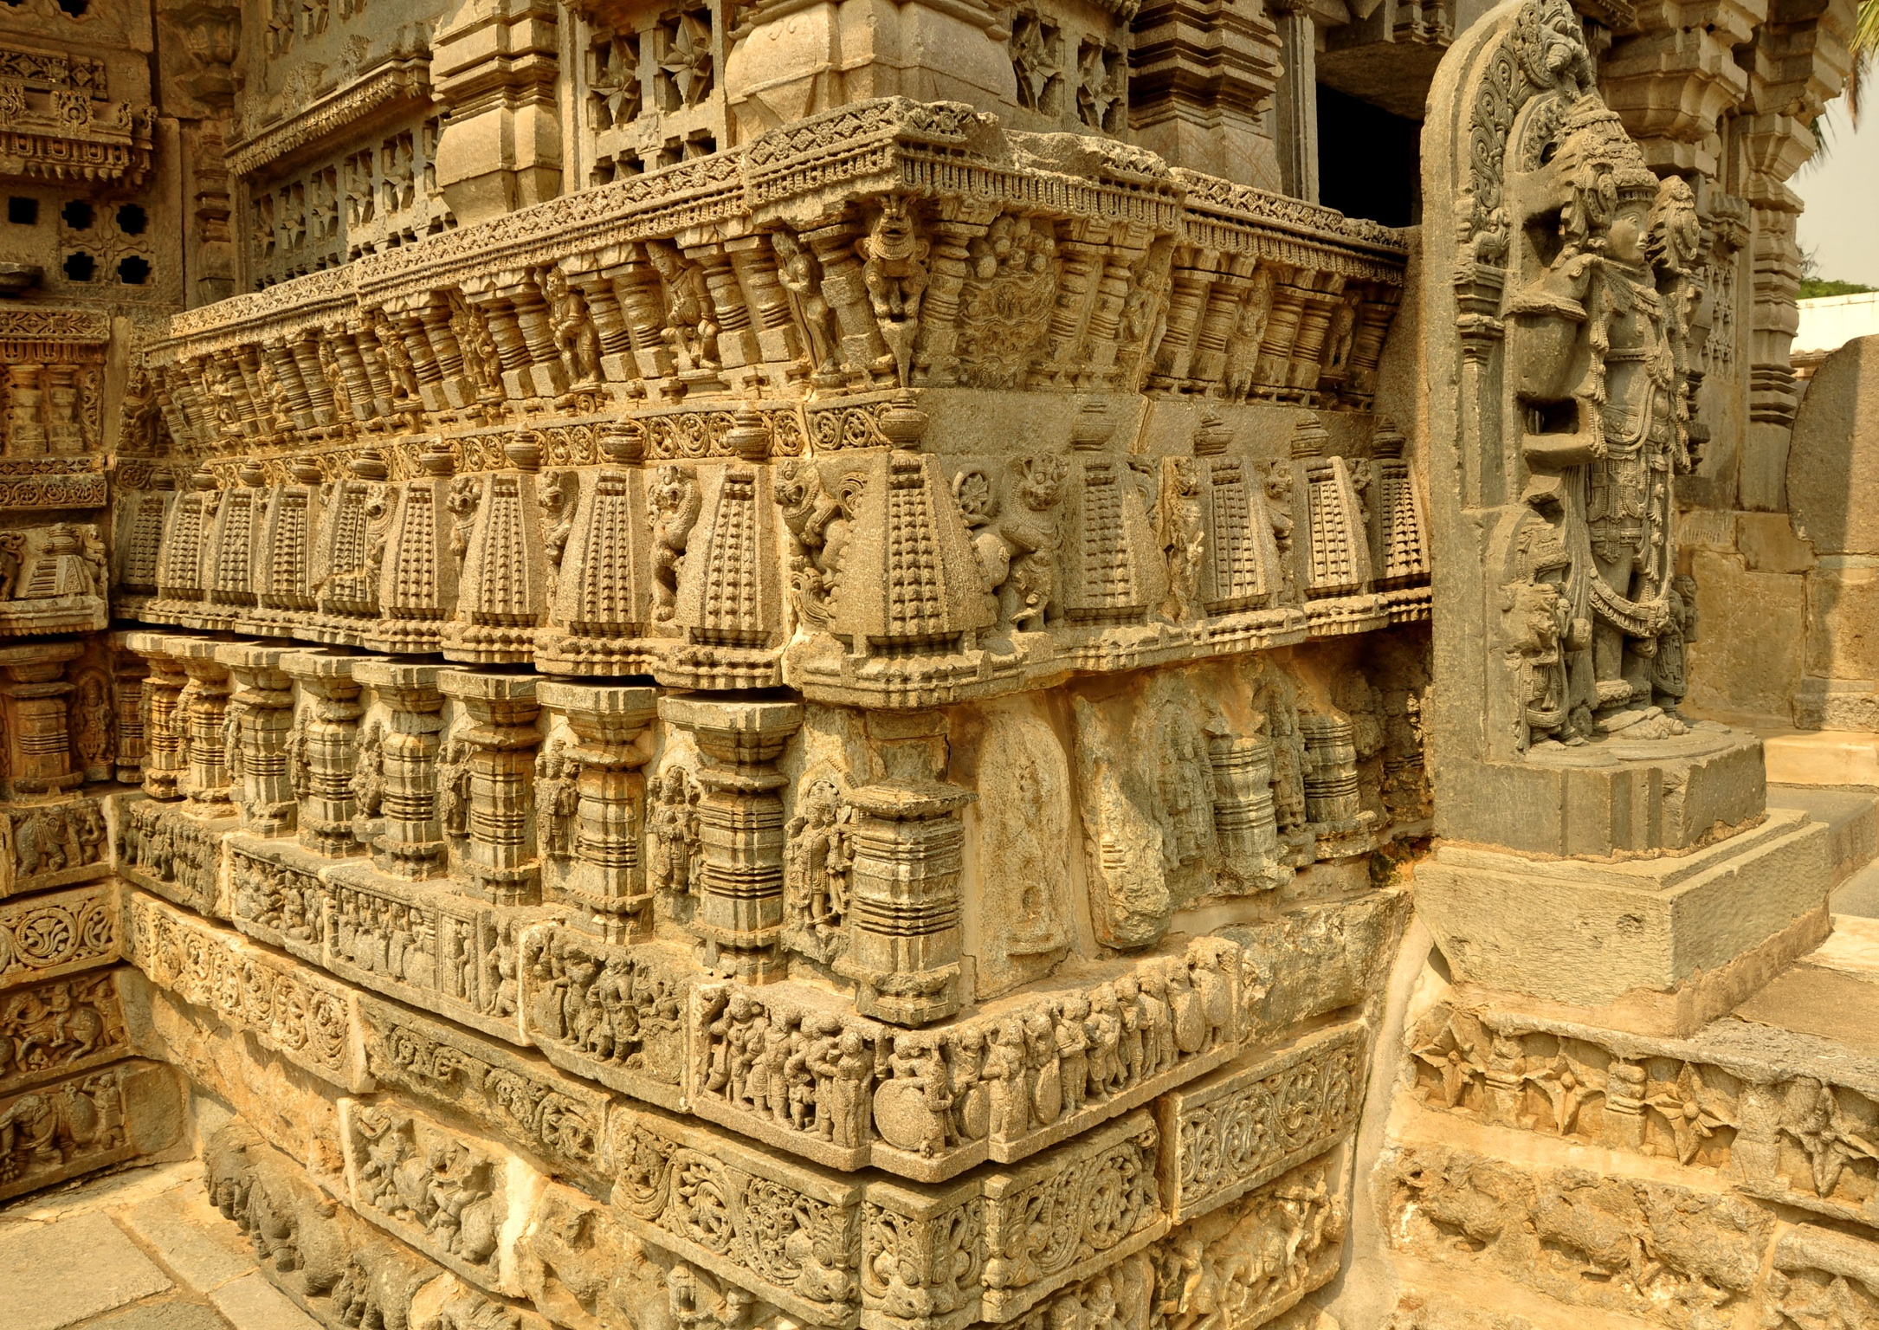
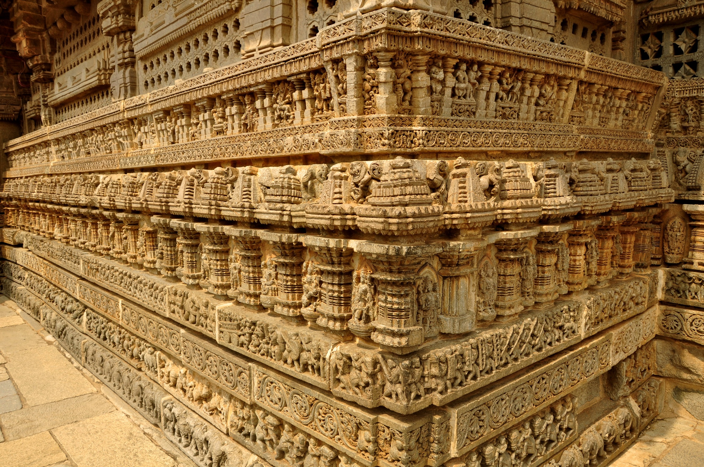

Slide 9
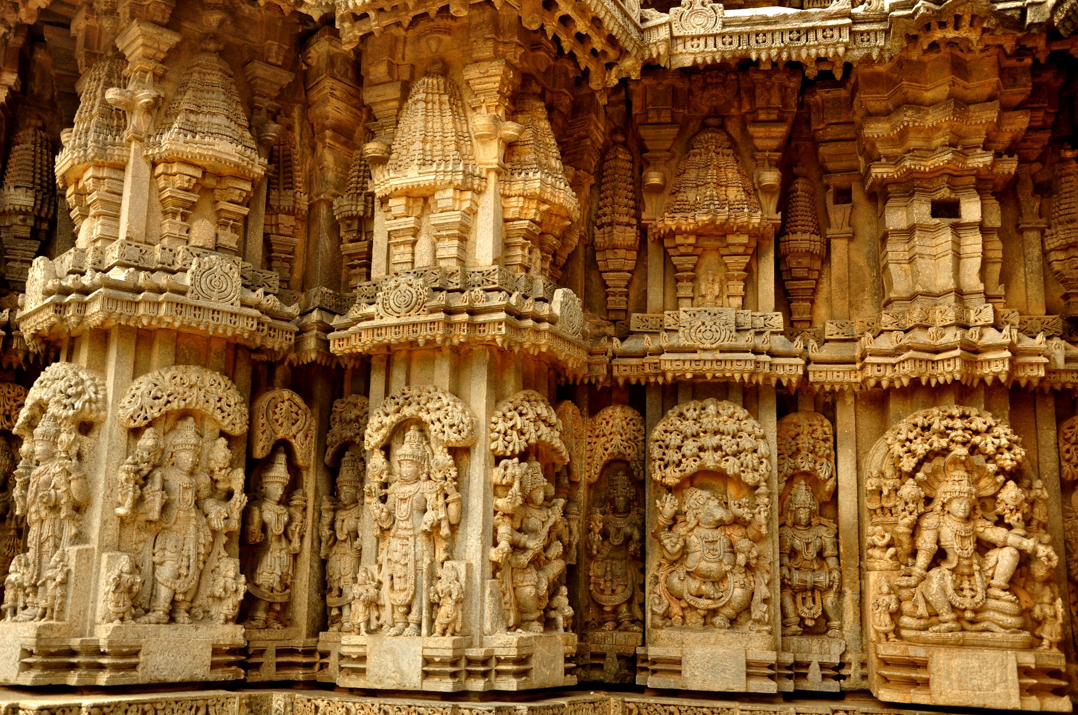

Slide 10
